Slide 1
Classical Art
Emerson PTA Art Appreciation Program
Grade 4

Slide 2
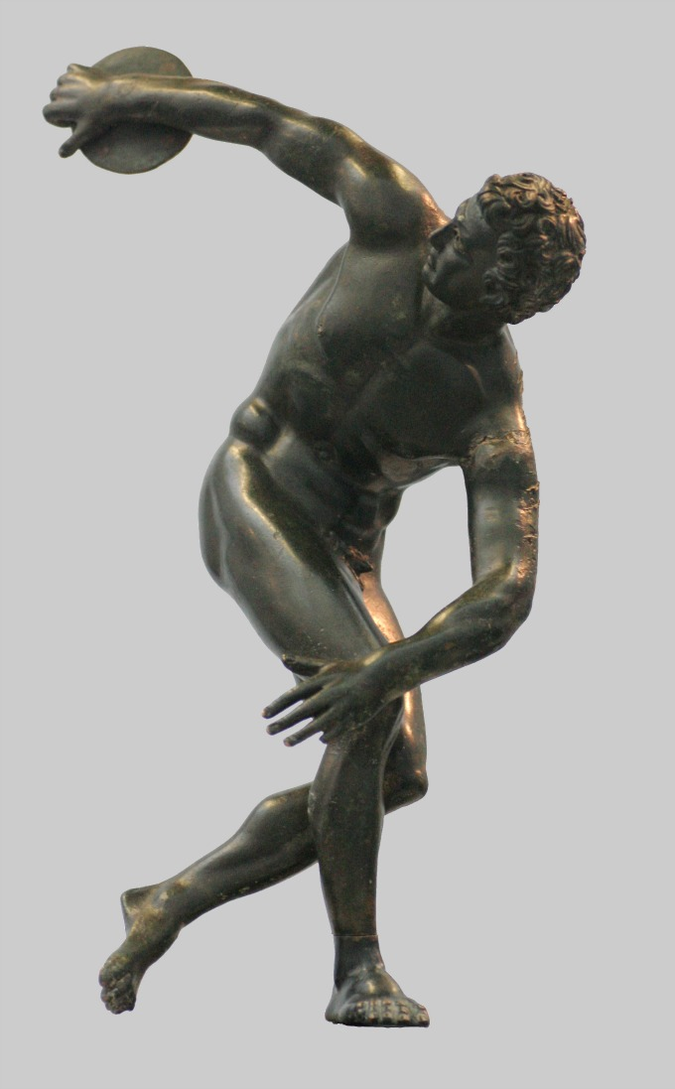
Discobolos (Discus Thrower) Myron, life-sized, 450 BC
Notes:
Questions to Ask the Kids:
This is a life-sized statue made in ancient Greece (450 BC) by the sculptor Myron. A discus is a round stone slab.
What is going on here?
What would happen next?
Does this action look natural? Why?
Does the shape of the body and the muscles look normal or correct?
Does this man look like a real person? How can you tell?
Does he look superhuman?
Does anything not look natural? What about the hair?
Background Information (for the presenter):
Greek sculptors wanted to represent a natural form moving in space at a moment in time. They studied the anatomy of the human body. As a result, for the first time in history, artists created sculptures that seemed as natural as human beings.Myron was the first of the great sculptors to to bring movement to his sculptures.
The power and tension in motion seem so real here that we feel we need to move aside to avoid being struck when the discus is let go. The proportions of the body are correct and show a great understanding of bone and muscle in the movement of the body
.The Greeks loved art and poetry and greatly admired skill in athletics. The city-states of Greece competed with each other not only in trade but in decorating their cities with the most beautiful statues and paintings, and in winning the most prizes at athletic meetings or games. The Olympic games originated in Greece in 766 BC.

Slide 3
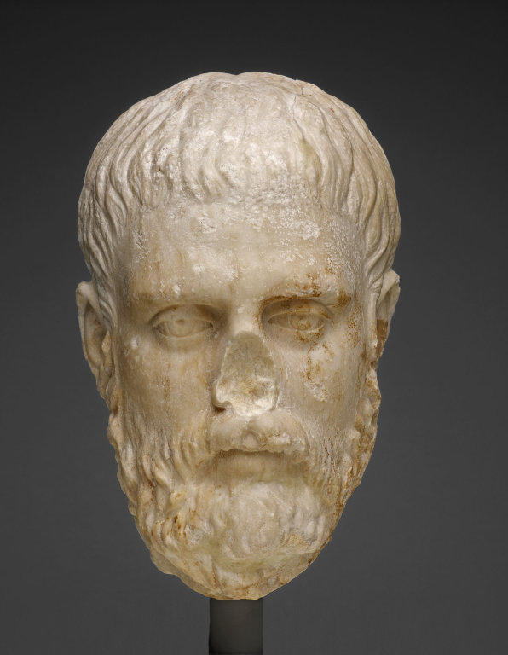
Head of a Philosopher 400-375 BC, marble AIC
Notes:
Questions to Ask the Kids:
How is this head of a philosopher, which is at the Art Institute of Chicago, similar to the statue we just saw?
Why do you think it is broken?
What kind of expression does this man have? Does he look real? Or natural?
Do you think this was an exact likeness of a particular man? Why?
This is carved from marble. Do you think that carving in marble is easy or difficult?
A philosopher is someone who likes to think about things like why are we here? What are we doing here? What is the meaning of life? What do you think this philosopher is thinking about?
Background Information (for the presenter):
We must remember that these statues are over 2,000 years old and many of them are broken. Most Greek statues were painted with bright colors originally, but through time, these colors have worn off. How different they must have looked when painted.
Statues the Greeks made were not of any one particular person. They made statues showing the most admirable characteristics of all human beings. We say their art is idealized; they showed only the most perfect and beautiful images of their models. This sculpture is at the Art Institute of Chicago.

Slide 4
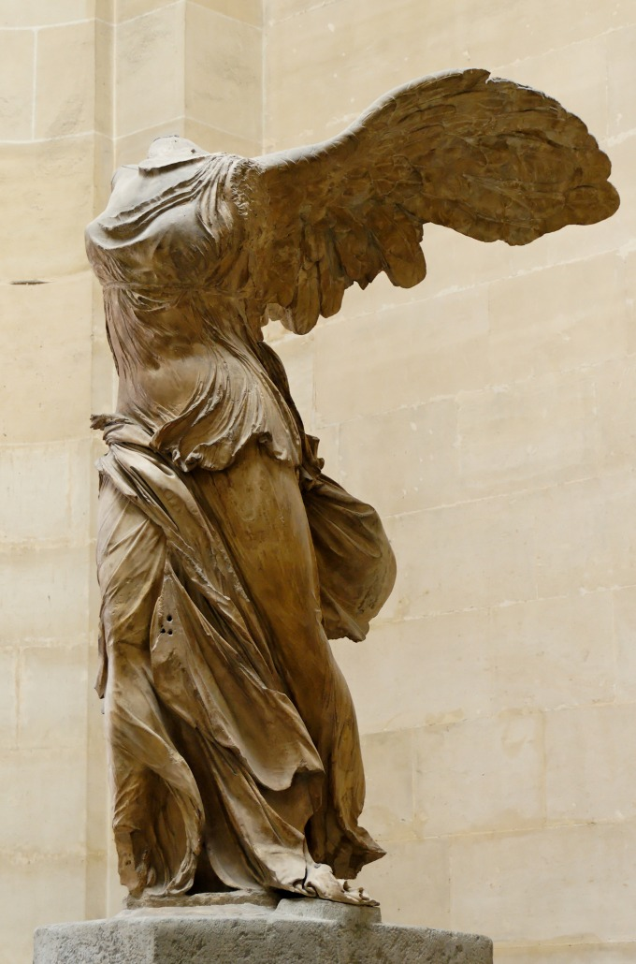
Nike of Samothrace 200-290 BC, marble
Notes:
Questions to Ask the Kids:
Do you see action in this sculpture?
What do you think is happening? How can you tell?
Have you ever seen anyone with wings?
Do you think she is real or made up?
Do you think her clothes look real or that robes would drape like that on you?
Why do you think her clothes are so tight on her? Does it have some connection with the wings?
What would your clothes look like if you were flying through the air?
Are her proportions correct?
Why do you think the shoe company Nike chose the name Nike for their shoes? Is it a good name? What do you think the Nike shoe company is trying to tell us about their shoes?
Background Information (for the presenter):
This is a sculpture of the Greek winged goddess of Victory, Nike, found on Samothrace, a Greek island in the Aegean Sea. Obviously, parts of her are missing. Originally she was displayed with a pool of water around her so that it looked like she was landing on the prow of a ship. The sculptor has captured the drama of swirling winds filling Nike's wings and pressing her robes tightly against her body, which looks beautiful, graceful, and natural.
According to the Greek myths (traditional stories of Greece), Nike was the Goddess of Victory. The Greeks believed in a large family of gods who were very much like humans; they did not worship animal gods. Each god ruled over a different part of human life. Nike was the goddess of Victory. This statue is at the Louvre Museum in Paris, France.

Slide 5
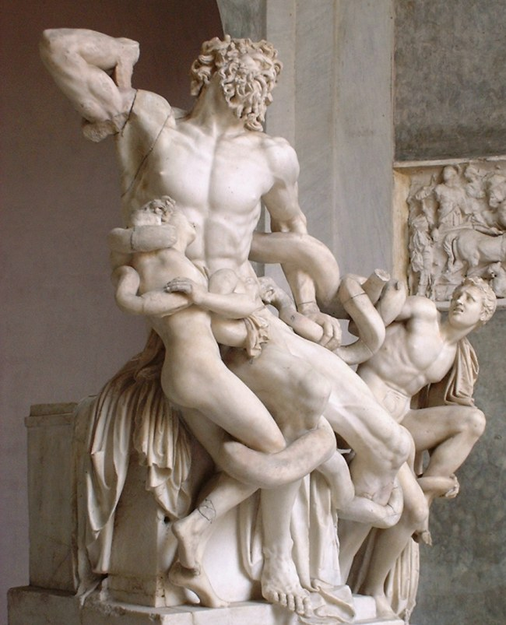
Laocoon Group 175-150 BC, marble
Notes:
Questions to Ask the Kids:
What is happening here?
Is there a lot of action going on in this sculpture?
What is it that adds to the action? Is there tension here?
Do you think this would look as exciting from the sides or the back? Why?
What do you think is going to happen to these people?
Do you think they will get away?
Do they look like real people?
Do you think their proportions and muscle structure is correct? Does it look normal or super-human?
Background Information (for the presenter):
According to the Greek myths, Laocoon was a priest of Apollo at Troy who warned the Trojans against the Trojan Horse. With his two sons, Laocoon was killed by serpents sent by Poseidon, God of the Sea.
This sculpture shows the great understanding the Greeks had for human anatomy and their appreciation of the workings of the bones and muscles in movement.

Slide 6
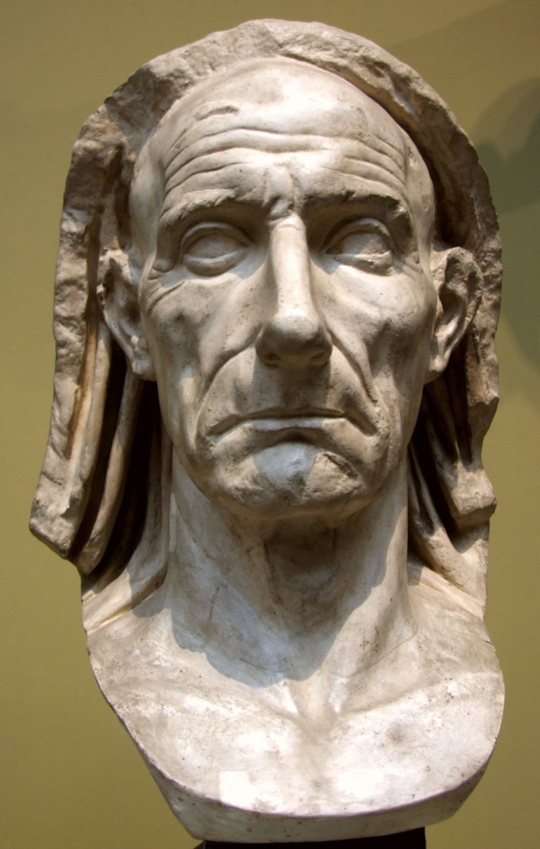
Portrait Head of a Man AD 50, Roman, marble
Notes:
Questions to Ask the Kids:
Does this look like the head of the philosopher we saw before?
What is different about it?
What kind of expression does this man have or what kind of mood is portrayed?
Can you tell his age? How?
What else can we tell about him?
Do you think this is a likeness of a particular man? Why?
Background Information (for the presenter):
For the most part, the ancient Romand imitated the art of the Ancient Greeks. Roman art in many ways is a continuation of Greek art. Most of what we know of Greek sculpture, for example, comes from the copies of Greek originals that were manufactured for the Roman market. The Discus Thrower is a Roman copy.
The Romans did add their contributions in the many sculptured portraits that they made. The ideal image of the Greeks was replaced by a realism that showed every wart and sagging muscle. In this portrait of a man, what looks different from the Greek Head of the Philosopher?

